Slide 1

Constrained Deep Learning for System Identification and Differentiable Predictive Control of Nonlinear Systems
Invited talk: IMT Lucca, 17th of June 2021
Jan Drgona
Collaborators: Elliott Skomski, Soumya Vasisht,
Aaron Tuor, Draguna Vrabie

Slide 2
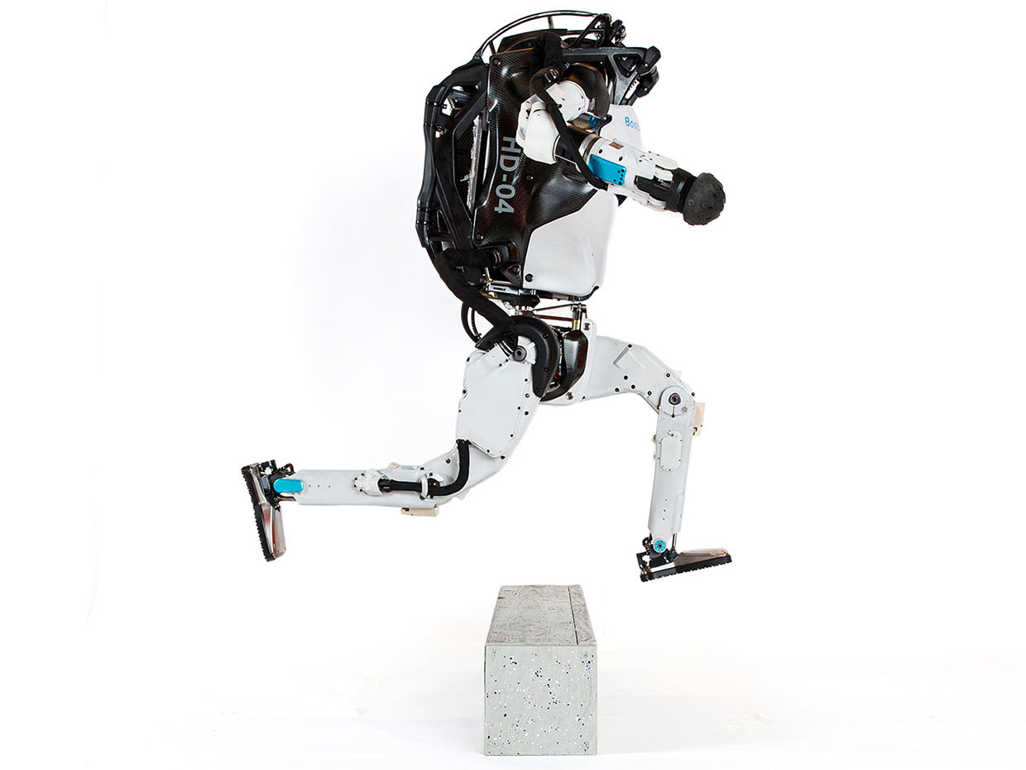


Model Predictive Control
Successes
Challenges
95% of the process control applications are PID loops using trial and error rule-based optimization. The rest is model predictive control (MPC).
Modeling
Unknown or partially known dynamics
Physics-based modeling is expensive
Purely data-driven models lack generalization
Real-time optimization
Scalability
Computational limitations of control hardware
Parallelization, distributed optimization
Assumption:
Reliable and accurate system dynamics model
Drgona J., J. Arroyo, I.C. Figueroa, D. Blum, K. Arendt, D. Kim, and E.P. Olle, J. Oravec, M. Wetter, D. L. Vrabie, L. Helsen. 2020. "All You Need to Know About Model Predictive Control for Buildings." Annual Reviews in Control, September 29, 2020
Notes:
Domain awareness, trusted autonomy
PID controller-
A PID controller continuously calculates an error value
the difference between a desired setpoint (SP) a process variable (PV) and
Correction based on proportion of error, integration of accumulated error, and derivative of the error
MPC first developed in the chemical industry to address some of the shortcomings of a PID controller.
Designed to handle MIMO systems
Can handle constraints
Preview capability
MPC uses a model to predict future outcomes of a process.
Online optimization problem at each process interval. Performs first action in the rollout.
requiring large memory and fast processor to operate in real time.
Training and calibration of models- lots of expert time
Optimization: translation to a solver language- lots of expert time
Computational limitations of control hardware depending on the system

Slide 3
Objective: Integrate Deep Learning with MPC and Physics
Automate learning of the system dynamics and model-based control policy
Streamline the installation process, facilitate explainability
Endow with lifelong learning and offer performance guarantees during the learning process

Slide 4
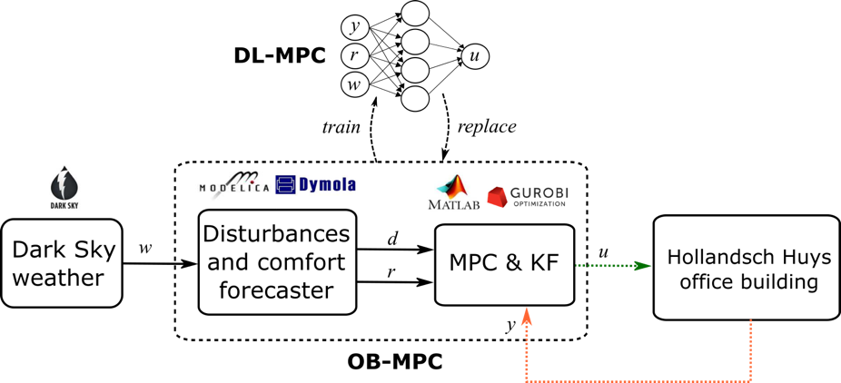
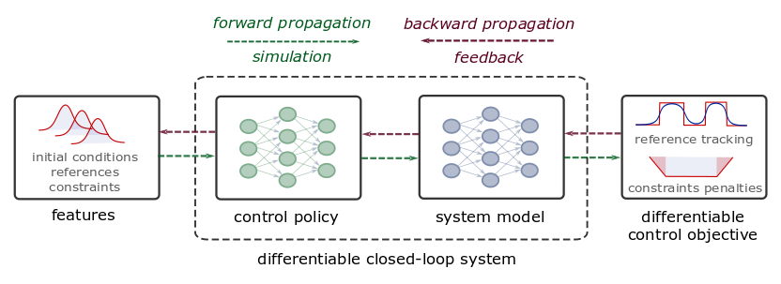
Deep Learning of MPC-based Control Policies
Approximate MPC
Supervised learning
Imitation learning of MPC
Requires original MPC
Requires system model
Differentiable Predictive Control
Neural state space models
Differentiable closed-loop model
Model-based policy optimization
Theoretical connection with MPC
Drgona J., et al., “Approximate model predictive building control via machine learning,” Applied Energy, 2018
Drgona J., Helsen L., Vrabie D., "Cutting the Deployment Costs of Physics-Based MPC in Buildings by Simulation-Based Imitation Learning.”, proceedings of Dynamic Systems and Control Conference 2020, - Best paper award

Slide 5

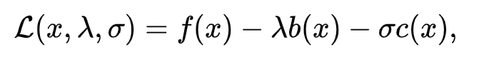
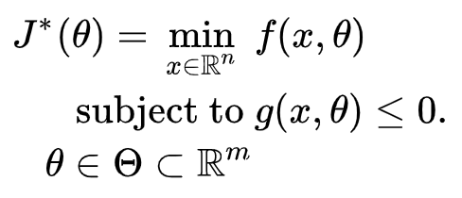

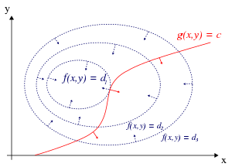
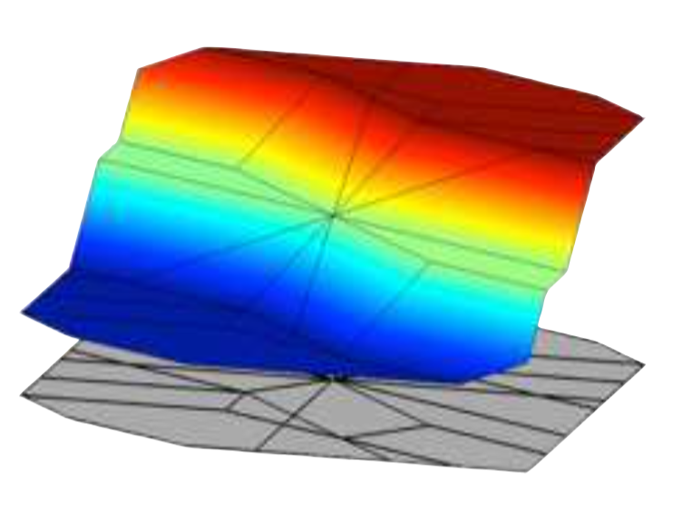


Formulations of Constrained Optimization Problems
Standard form
Lagrangian form
Parametric programming
Machine learning
“online” optimization
Single solution for
given parameter values
“online” optimization
Using soft constraints
Instead of hard constraints
“offline” optimization
Obtains a solution map
for a set of parameters
“offline” optimization
Obtains a model (map)
for a set of datapoints

Slide 6
Formulations of Constrained Optimization Problems
Standard form
Lagrangian form
Parametric programming
Machine learning
“online” optimization
Single solution for
given parameter values
“online” optimization
Using soft constraints
Instead of hard constraints
“offline” optimization
Obtains a solution map
for a set of parameters
“offline” optimization
Obtains a model (map)
for a set of datapoints
Data-driven differentiable parametric optimization (D3PO): Combining principles of
Lagrangian formulation, parametric programming and ML

Slide 7
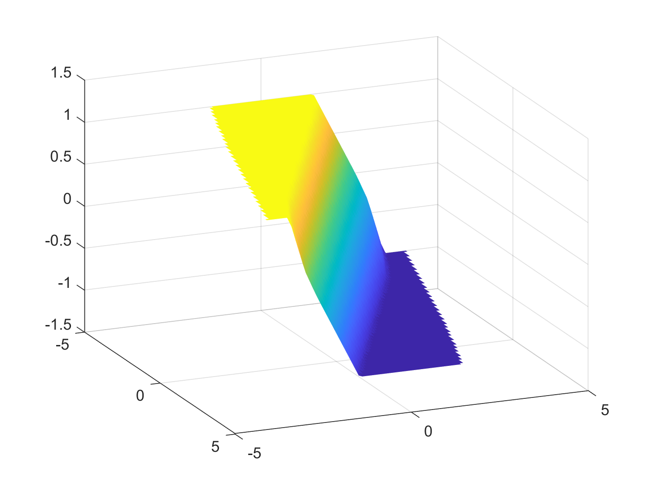
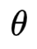
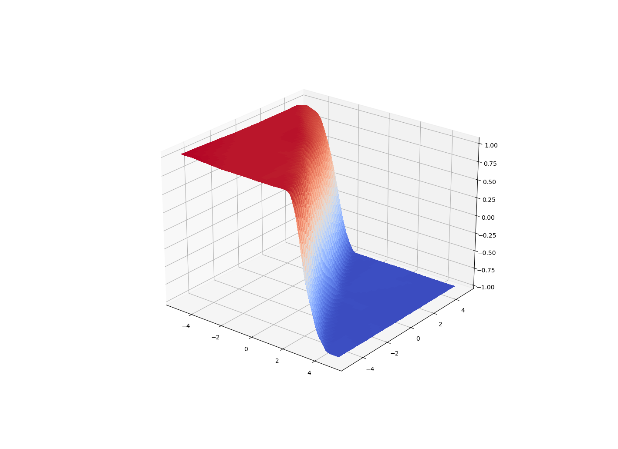
Data-Driven Differentiable Parametric Optimization (D3PO)
D3PO problem definition:
Applications:
Optimization
Modeling
Control
with constraints
Solution of parametric quadratic
program with classical solver.
Optimize x, given dataset
by finding a mapping x=h( )
D3PO implementation using Neuromancer:
import neuromancer as nm dataset = nm.datasets.Dataset(sequences=data)
components = nm.policies.SolutionMap(**kwargs) objectives = nm.Objective(torch.norm(z, 2)), weight=Q_x) constraints = nm.Objective(torch.norm(F.relu(torch.mm(A, z.T)-b), 1), weight=Q_con) problem = nm.Problem(objectives, constraints, components)
optimizer = torch.optim.AdamW(model.parameters(), lr)
trainer = nm.Trainer(problem, dataset, optimizer, epochs) best_model = trainer.train()
D3PO solution of
parametric quadratic program.
https://github.com/pnnl/neuromancer
https://github.com/pnnl/slim

Slide 8
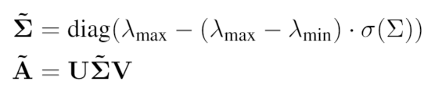
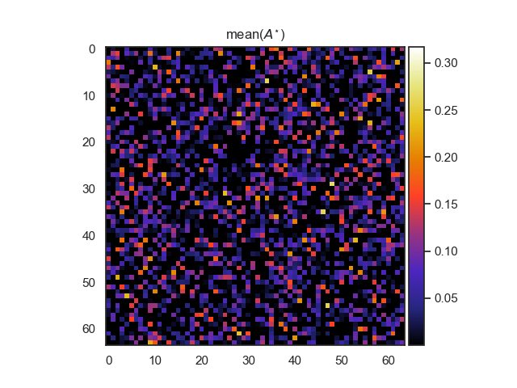
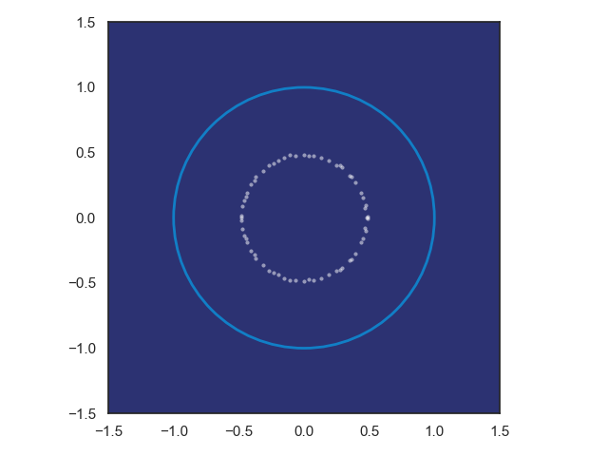
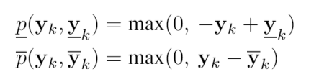
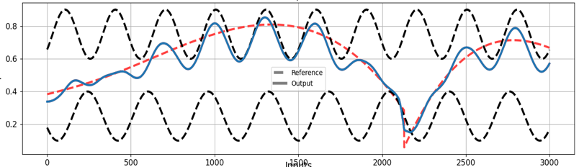
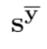
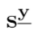
Constrained Neural Models in D3PO
Structured linear algebra:
Eigenvalues, sparsity, rank, positive definiteness
Loss function terms:
Regularizations
Penalty methods
Physics-informed neural networks
Neural models for dynamical systems:
Neural state space models
Energy-based models
Constrained optimal control
Differentiable predictive control
https://github.com/pnnl/neuromancer
https://github.com/pnnl/slim

Slide 9
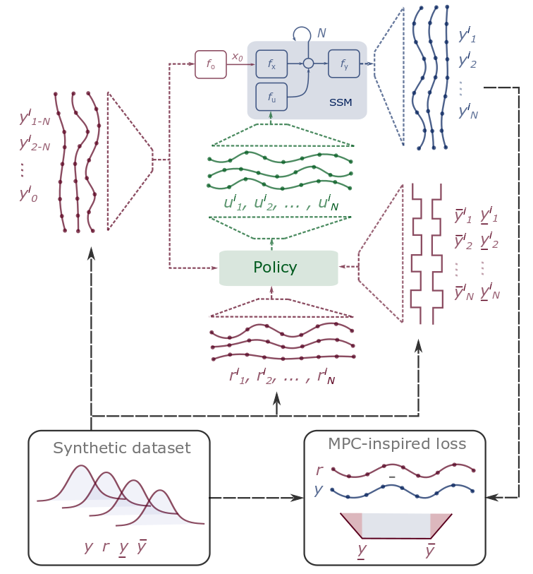
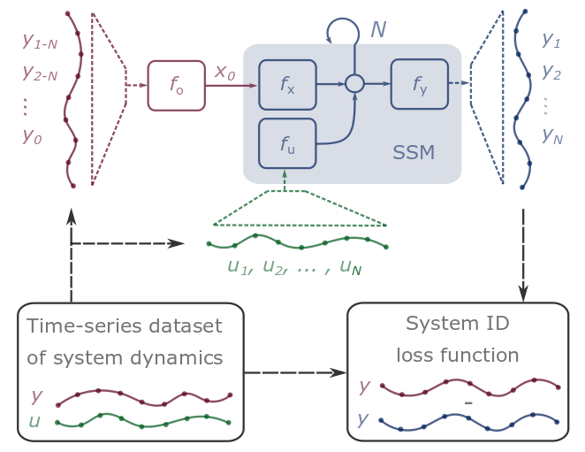
Differentiable Predictive Control (DPC)
Stage I: System Identification
Stage II: Policy Optimization
Notes:
Integrate Deep Learning with Optimization-Based Control
Machine learning models that respect physical laws
Incorporate domain knowledge in their architectures
Incorporate domain knowledge with auxiliary loss functions
Use cases
Optimal control
Predictive maintenance
Surrogates for inverse problems
Forecasting for high level planning
Configurable optimization
Sequential
Joint
Alternating
Online updates
Scalable inference
Fast sampling rates
Limited computational resources
High dimensional state space
Long prediction horizons

Slide 10
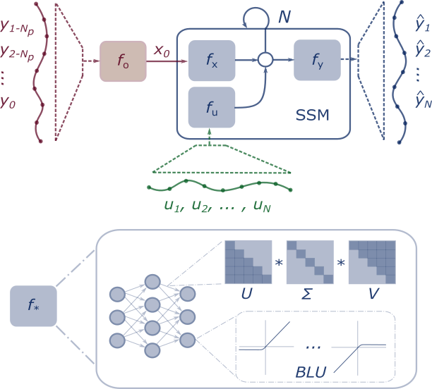
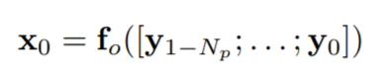
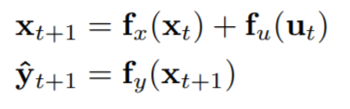
Constrained Neural State Space Models
Machine learning models that respect physical laws and constraints
Structured architectures
Physics-informed loss functions
Constraints enforcing penalties
Learnable activation functions
Structured linear maps
Elliott Skomski, et al., Constrained Block Nonlinear Neural Dynamical Models, American Control Conference (ACC) 2021.
A. R. Tuor, J. Drgona, D. L. Vrabie, Constrained Neural Ordinary Differential Equations with Stability Guarantees, ICML workshop 2020.

Slide 11
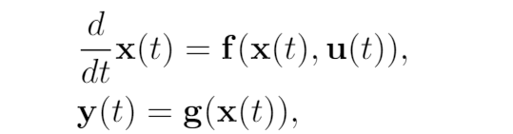
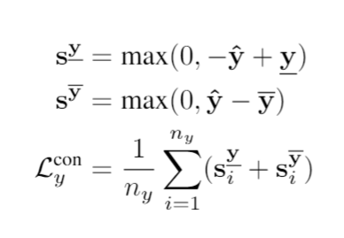
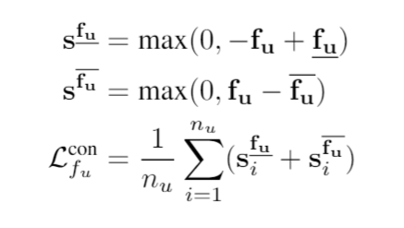
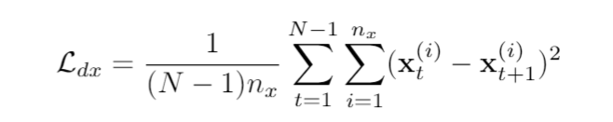
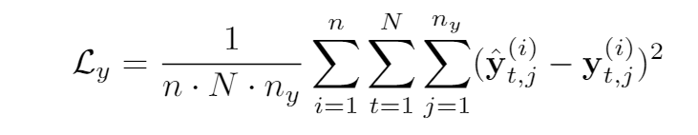
Training Constrained Neural State Space Models
Partially observable non-autonomous system
Bound influence of input and bound output to physical range
Dataset:
Predicted State Smoothing
Multi-term loss function:
Optimize N-step prediction horizon MSE
Elliott Skomski, Ján Drgoňa, Aaron Tuor, Automating Discovery of Physics-Informed Neural State Space Models via Learning and Evolution, Proceedings of the 3rd Conference on Learning for Dynamics and Control (L4DC), 2021.

Slide 12
Modeling Thermal Dynamics with Domain-aware Model Design
Ján Drgona, et al., Physics-constrained deep learning of multi-zone building thermal dynamics, Energy and Buildings, 2021

Slide 13
Real World Data: Office Building

Slide 14
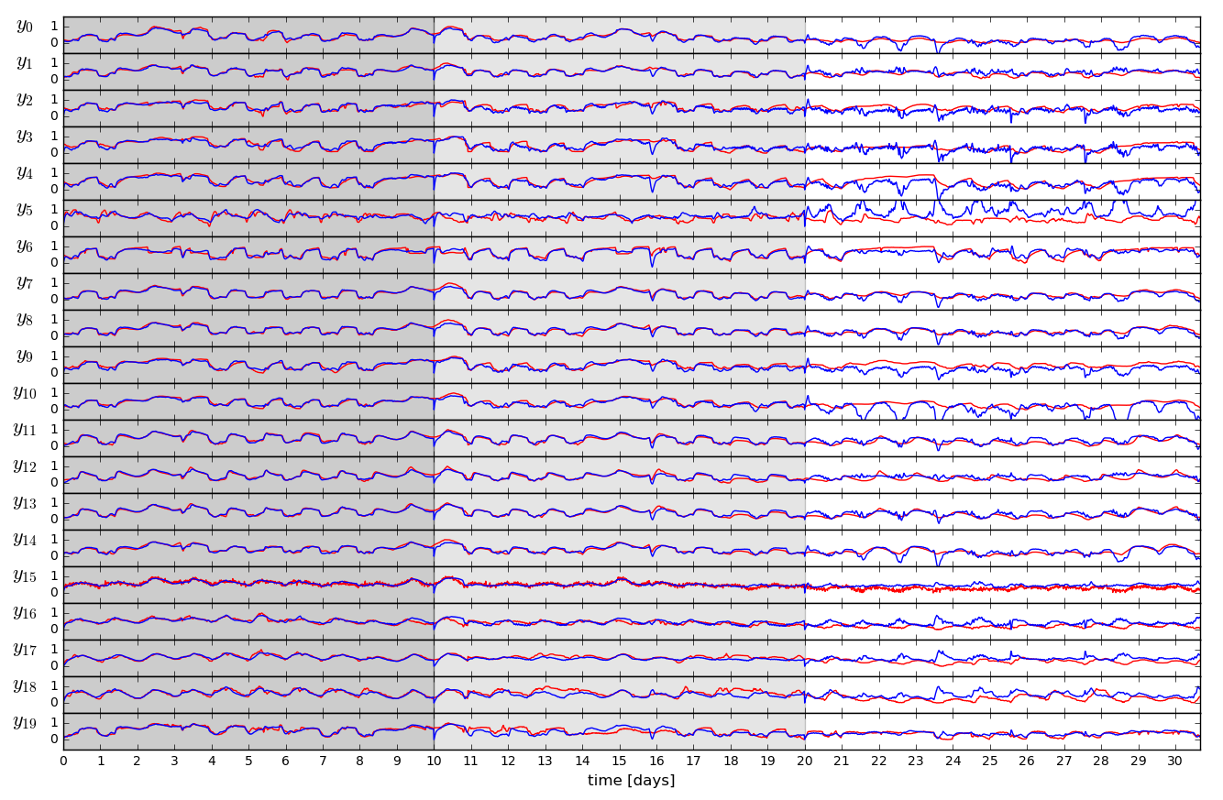
Open-loop Trajectories of Linear Dynamics Model
Ján Drgona, et. al, Physics-constrained deep learning of multi-zone building thermal dynamics, Energy and Buildings, 2021

Slide 15
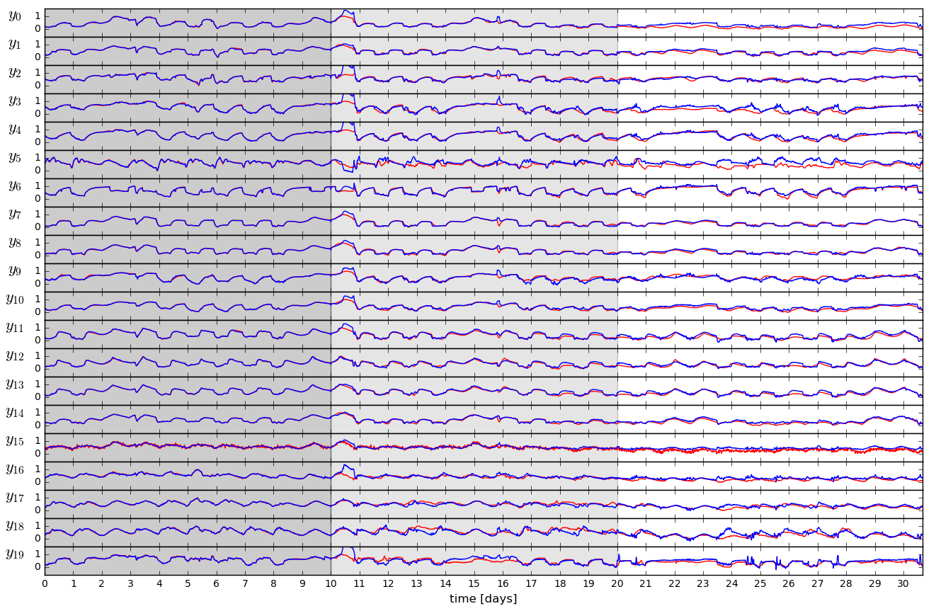
Open-loop Trajectories of Neural Dynamics Model
Ján Drgona, et. al, Physics-constrained deep learning of multi-zone building thermal dynamics, Energy and Buildings, 2021

Slide 16
Differentiable Predictive Control (DPC)
Generic method for constrained model-based control
Can be trained end-to-end from time series dataset
Nonlinear constrained optimal control
Explicit neural network-based control policy
Scalability beyond the limitations of explicit MPC
[1] Jan Drgona, et al., Differentiable Predictive Control: An MPC Alternative for Unknown Nonlinear Systems using Constrained Deep Learning https://arxiv.org/abs/2011.03699
[2] Jan Drgona, Aaron Tuor, Draguna Vrabie, Constrained Physics-Informed Deep Learning for Stable System Identification and Control of Unknown Linear Systems https://arxiv.org/abs/2004.11184

Slide 17
Model Predictive Control vs Differentiable Predictive Control
DPC = Formulation of MPC problem as a constrained deep learning model
Jan Drgona, Aaron Tuor, Draguna Vrabie, Constrained Physics-Informed Deep Learning for Stable System Identification and Control of Unknown Linear Systems https://arxiv.org/abs/2004.11184

Slide 18
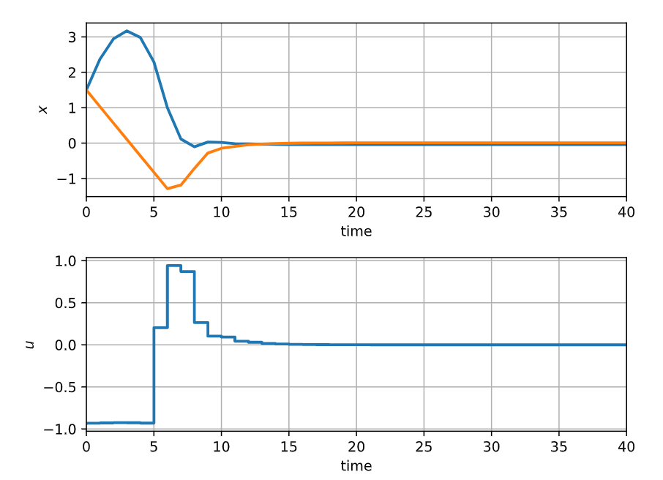
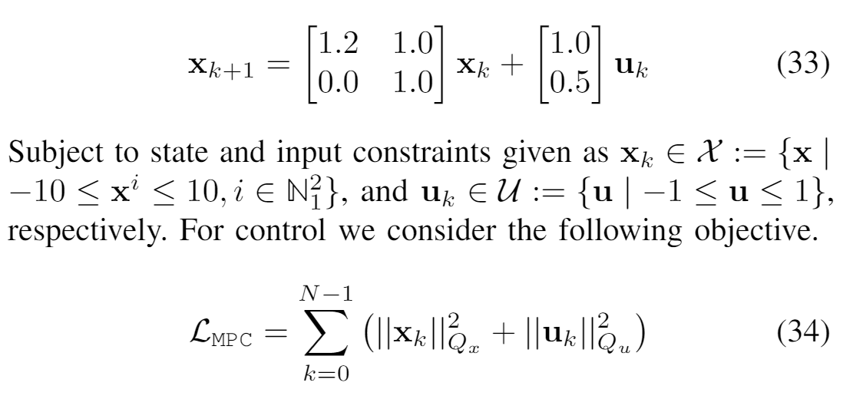
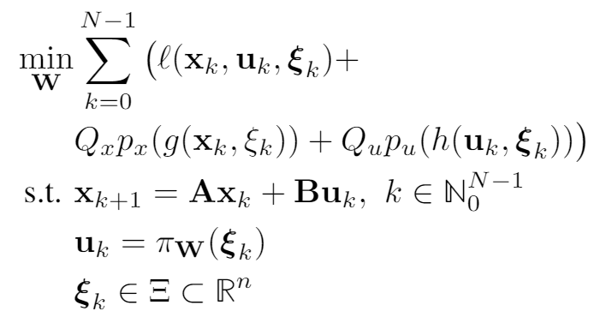
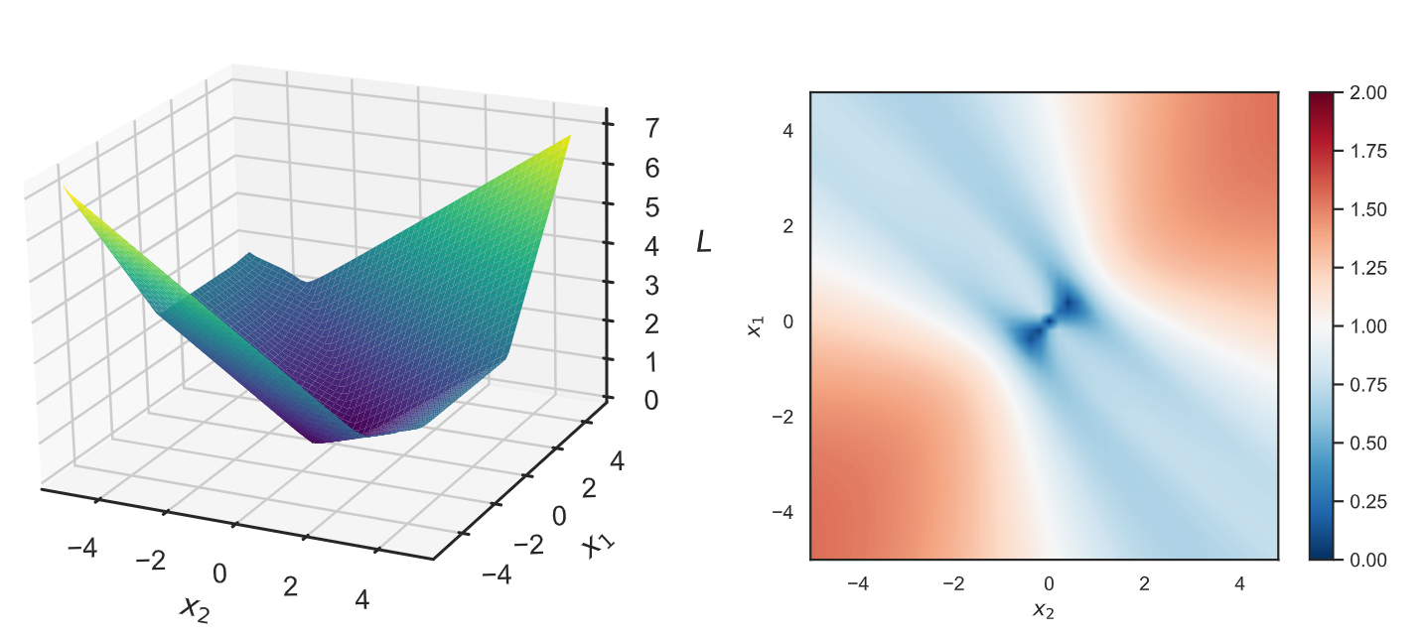
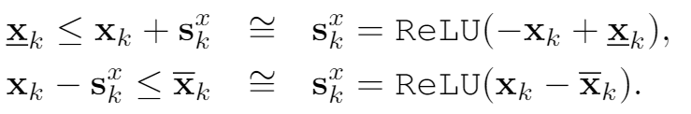
Learning to Stabilize Known Unstable System with DPC
Problem setup:
DPC formulation:

Slide 19
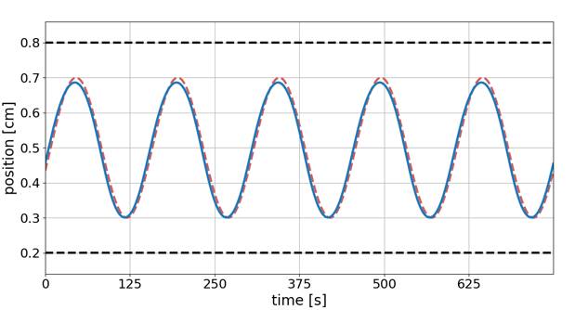
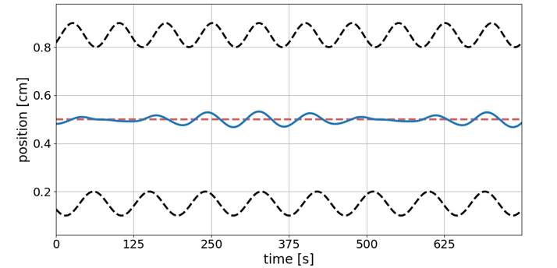
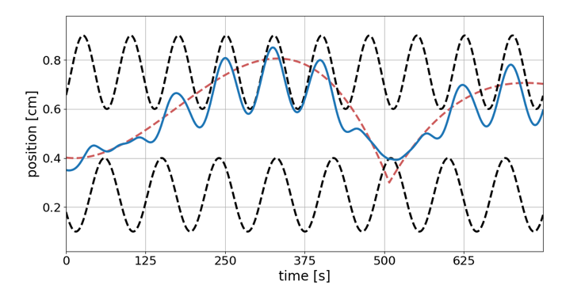
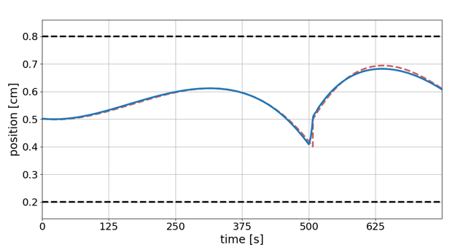
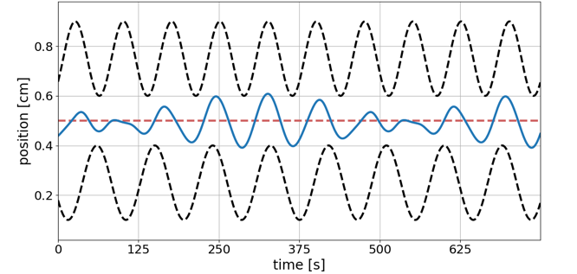
DPC capability: Computationally efficient offline optimization with operational safety constraints
--- Reference trajectory
--- Constraints
__ Controlled trajectory
Reference tracking performance
Response to constraint tightening
Balancing conflicting objectives
Notes:
Computationally efficient performance optimization with operational safety constraints

Slide 20
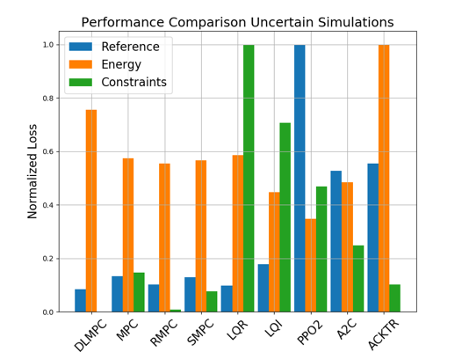
Comparison of DPC with MPC, LQR, and RL on Unknown Linear System with Disturbances
Closed loop trajectories. Top: controlled state (orange), internal model predictions (green), given reference (dashed blue), and constraints (dashed black). Middle: control action (blue) and bounds (dashed black). Bottom: disturbances
Control performance comparison in simulations with parametric and additive uncertainties. Control Strategies: MPC, Robust MPC , Stochastic MPC, LQR, LQI, A2C: Asynchronous, deterministic variant of Advantage Actor Critic, ACKTR: Actor Critic using Kronecker-Factored Trust Region, PPO2: Proximal Policy Optimization
Drgona J., Tuor A., Vrabie D., Constrained Physics-Informed Deep Learning for Stable System Identification and Control of Linear Systems, Code release: https://github.com/pnnl/deps_arXiv2020

Slide 21

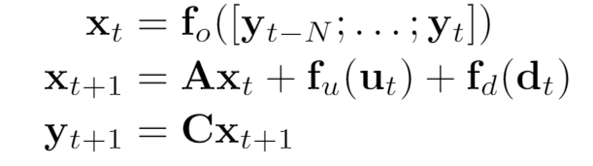
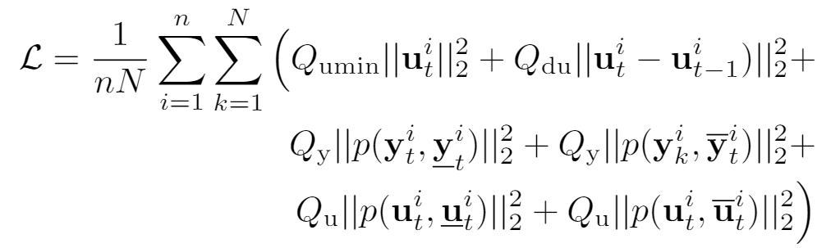
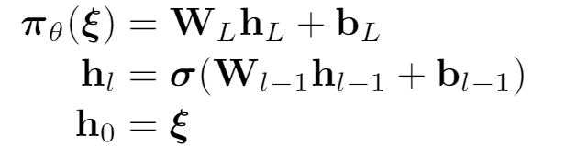
Economic DPC for Building Control
Economic MPC loss function
model
policy
Jan Drgona, Aaron Tuor, Elliott Skomski, Soumya Vasisht, Draguna Vrabie, Deep Learning Explicit Differentiable Predictive Control Laws for Buildings, accepted for IFAC NMPC 2021

Slide 22
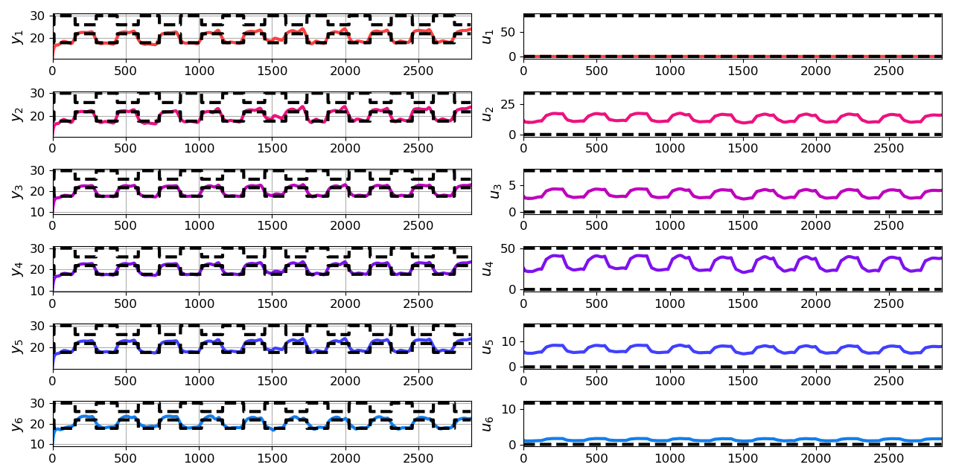
Closed-loop Performance of DPC on Learned Model without Plant-Model Mismatch
Jan Drgona, Aaron Tuor, Elliott Skomski, Soumya Vasisht, Draguna Vrabie, Deep Learning Explicit Differentiable Predictive Control Laws for Buildings, accepted for IFAC NMPC 2021

Slide 23
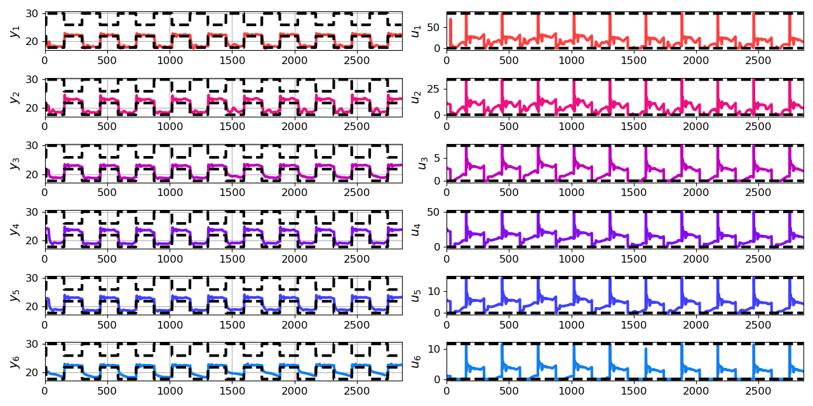
Closed-loop Performance of DPC on Emulator Model with Plant-Model Mismatch
Jan Drgona, Aaron Tuor, Elliott Skomski, Soumya Vasisht, Draguna Vrabie, Deep Learning Explicit Differentiable Predictive Control Laws for Buildings, accepted for IFAC NMPC 2021

Slide 24
Embedded Implementation of DPC
Flexy-Air system sketch with Raspberry-Pi controller
Performance comparison: reference (red dashed), position controlled with PI controller (green), explicit model predictive control (purple), constrained differentiable predictive control (blue) and constraints (black-dashed). Bottom figures show the fan speed controls
Jan Drgona, Karol Kis, Aaron Tuor, Draguna Vrabie, Martin Klauco, Differentiable Predictive Control: An MPC Alternative for Unknown Nonlinear Systems using Constrained Deep Learning; arXiv:2011.03699

Slide 25
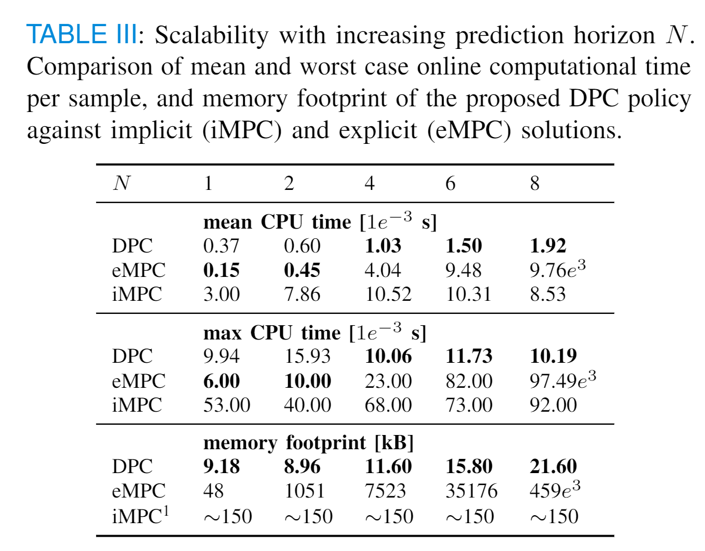
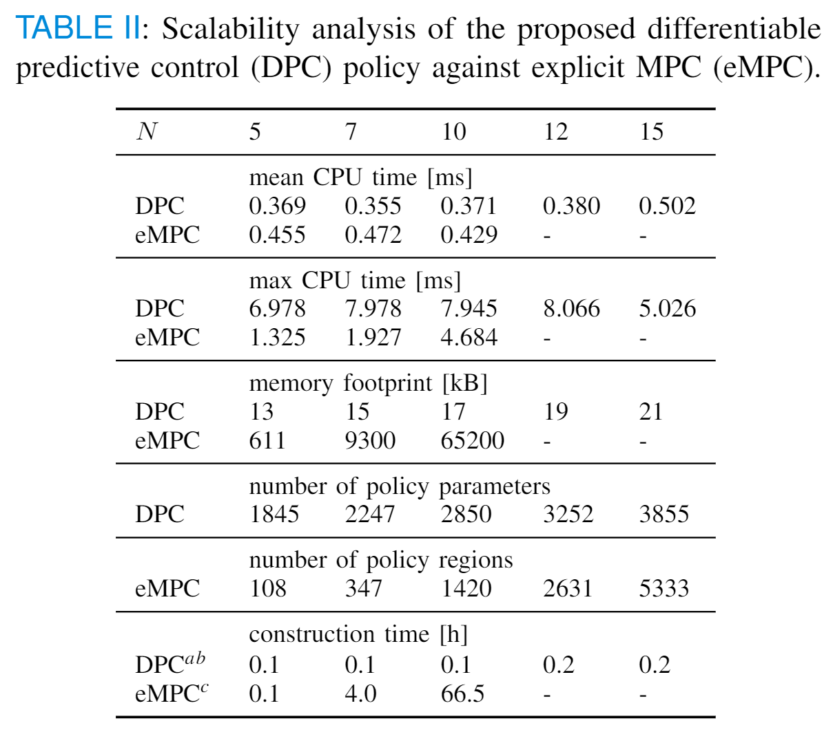
Scalability Analysis of DPC

Slide 26
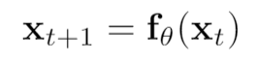
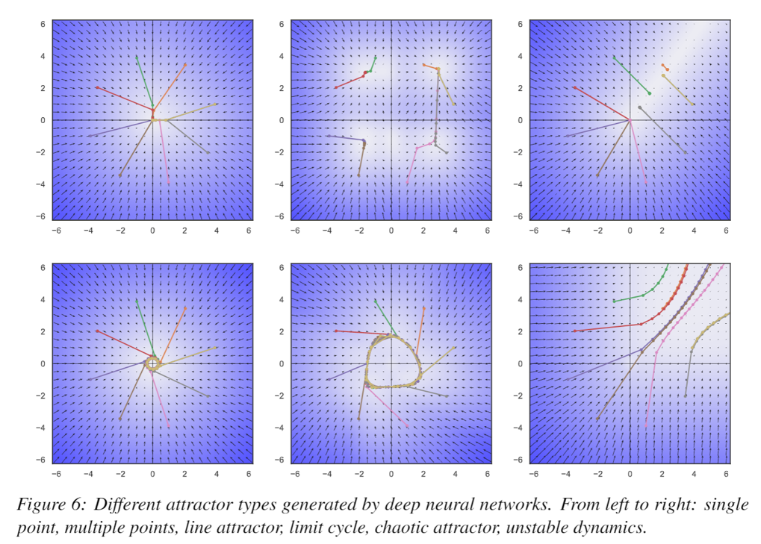
Stability Analysis of Neural Dynamics
Exploring connections between:
Deep neural networks
Piecewise affine (PWA) maps
Contraction of PWA maps
Banach fixed point theorem
Stability of linear switched systems
Stability of neural feedback systems
2D attractors generated by deep neural networks.

Slide 27
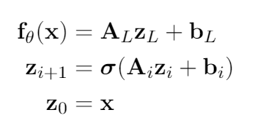






Deep Neural Networks as Pointwise Affine Maps
Deep feedforward neural network
At every point , the neural network, without bias may be represented as
where represent the weight parameterizations at layer , and is a diagonal matrix that represents the element-wise application of the nonlinear activation function at layer .
Jan Drgona, Aaron Tuor, Soumya Vasisht, Elliott Skomski, Draguna Vrabie, Spectral Analysis and Stability of Deep Neural Dynamics, arXiv:2011.13492
Notes:
The presentation I’m giving today is for a data-driven method for dynamics modeling.
We should care about this because people interact with and depend on complicated systems all the time.
Greater understanding of these systems can lead to outcomes which are
More energy efficient
Cost effective
Conducive to human life
Having an accurate model of a system enables scientific discovery,
Can provide critical information to support high stakes decisions in changing environments
Or to provide necessary information for predictive maintenance of high value equipment, avoiding costly and potentially dangerous equipment
Failures.
One of the most common and lucrative uses of systems models are for predictive control in manufacturing and other large scale enterprises.
I’m presenting a method today which bridges benefits of traditional physics-based modeling with more recent data-driven modeling using deep learning
Traditional physics-based modeling works very well and is widely used in many real world applications. However, it can’t always be applied to every situation.
missing information
incomplete awareness of the model state space.
limitations on the available operational data.
For large scale systems, not only are they difficult to model from first principles, it is also not always possible to simulate the system in real time.
Data-driven approaches for systems modeling are an alternative in these situations but can come with their own disadvantages.
Can take a lot of data to train and may behave unpredictably outside the distribution of training data in unobserved regions of the system state space.
In addition, modern neural network approaches don’t typically provide constraints enforcement within physically realizable and operationally safe bounds,

Slide 28


Asymptotic Stability of Deep Neural Dynamics
Notes:
The presentation I’m giving today is for a data-driven method for dynamics modeling.
We should care about this because people interact with and depend on complicated systems all the time.
Greater understanding of these systems can lead to outcomes which are
More energy efficient
Cost effective
Conducive to human life
Having an accurate model of a system enables scientific discovery,
Can provide critical information to support high stakes decisions in changing environments
Or to provide necessary information for predictive maintenance of high value equipment, avoiding costly and potentially dangerous equipment
Failures.
One of the most common and lucrative uses of systems models are for predictive control in manufacturing and other large scale enterprises.
I’m presenting a method today which bridges benefits of traditional physics-based modeling with more recent data-driven modeling using deep learning
Traditional physics-based modeling works very well and is widely used in many real world applications. However, it can’t always be applied to every situation.
missing information
incomplete awareness of the model state space.
limitations on the available operational data.
For large scale systems, not only are they difficult to model from first principles, it is also not always possible to simulate the system in real time.
Data-driven approaches for systems modeling are an alternative in these situations but can come with their own disadvantages.
Can take a lot of data to train and may behave unpredictably outside the distribution of training data in unobserved regions of the system state space.
In addition, modern neural network approaches don’t typically provide constraints enforcement within physically realizable and operationally safe bounds,

Slide 29

Dynamical Effects of Weights
Jan Drgona, Aaron Tuor, Soumya Vasisht, Elliott Skomski, Draguna Vrabie, Spectral Analysis and Stability of Deep Neural Dynamics, arXiv:2011.13492

Slide 30


Dynamical Effects of Biases and Depth
Jan Drgona, Aaron Tuor, Soumya Vasisht, Elliott Skomski, Draguna Vrabie, Spectral Analysis and Stability of Deep Neural Dynamics, arXiv:2011.13492

Slide 31


Dynamical Effects of Activation Functions
Jan Drgona, Aaron Tuor, Soumya Vasisht, Elliott Skomski, Draguna Vrabie, Spectral Analysis and Stability of Deep Neural Dynamics, arXiv:2011.13492

Slide 32



Stability Analysis of Neural State Space Models
Two tank system: 2 states x, 2 inputs u
Exothermic stirred tank reactor system: 2 states x, 1 input u

Slide 33




Stability of Full State Neural Feedback Systems
Closed-loop system with linear system dynamics and neural policy:
Pointwise affine form of the neural control policy:
Pointwise affine form of the closed-loop system with neural policy:
Jan Drgona, Aaron Tuor, Draguna Vrabie, Learning Stable Adaptive Explicit Differentiable Predictive Control for Unknown Linear Systems, under review, 2021

Slide 34









Conclusion
Differentiable Predictive Control
Neural state space model for system ID
Incorporating constraints (neural gray-box)
Theoretical connection with MPC
Explicit neural control policies
Embedded implementation with low-cost HW
Ongoing work
Uncertainty Quantification
Plant-model mismatch
Theoretical guarantees: convergence, stability, constraints satisfaction
Code development
Neuromancer software package
https://github.com/pnnl/neuromancer
Structured linear maps in Pytorch
https://pnnl.github.io/slim/
Long-Term Vision
Causal discovery, dynamical coupling
Solving large-scale non-convex constrained optimization problems
Applications in energy, manufacturing, cyber

Slide 35

Attractors of Deep Neural Networks
Jan Drgona, Aaron Tuor, Soumya Vasisht, Elliott Skomski, Draguna Vrabie, Spectral Analysis and Stability of Deep Neural Dynamics, arXiv:2011.13492

Slide 36
Attractors of Deep Neural Networks
Jan Drgona, Aaron Tuor, Soumya Vasisht, Elliott Skomski, Draguna Vrabie, Spectral Analysis and Stability of Deep Neural Dynamics, arXiv:2011.13492

